Slide 1
Welcome to the DOE Voucher Recipient Q&A
This webinar is being recorded and will be published online
If you do not wish to have your voice recorded, please do not speak during the call
If you do not wish to have your image recorded, please turn off your camera or
participate by phone
If you speak during the call or use a video connection, you are presumed to consent to
recording and use of your voice or image
Please mute your phones and we’ll begin momentarily

Slide 2
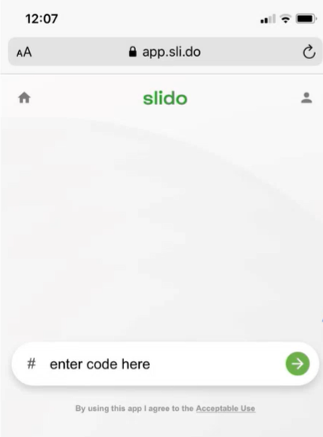
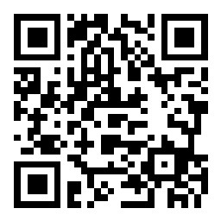
Submit Questions in Slido
Visit https://app.sli.do/event/8KJPUZk1Mp5SJvMf8WnTyK
or scan the QR code below:
OR go to www.slido.com
Using your mobile device or web browser and enter event code #Dec7OfficeHours
Send technical assistance
Questions in TEAMS CHAT
To Host

Slide 3
IAC Implementation Grants Overview
Mustafa Mahmoud, Clifton Yin
Deployment Managers
Office of Manufacturing and Energy Supply Chains
U.S. Department of Energy
November 16th, 2023

Slide 4
Welcome!
This webinar is being recorded and will be published online
If you do not wish to have your voice recorded, please do not speak during the call
If you do not wish to have your image recorded, please turn off your camera or participate by phone
If you speak during the call or use a video connection, you are presumed to consent to recording and use of your voice or image
Please mute your phones and we’ll begin momentarily

Slide 5
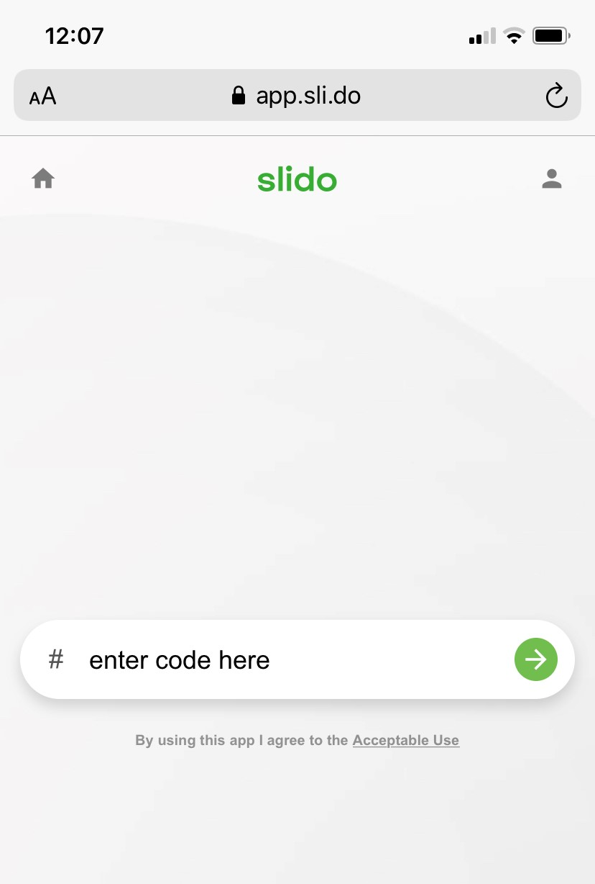
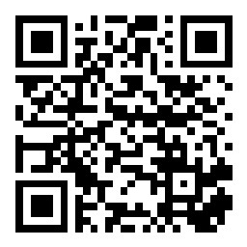
Submit Questions in Slido
Visit https://app.sli.do/event/kyXLKxRK4HVcjsbZSyxXFy or scan the QR code below
OR go to www.slido.com
using your mobile device or web browser and enter event code #Nov16OfficeHours
Select the room that fits your question (Workstream 1: Implementation Grants Applications or Workstream 2: Third-Party Assessor Applications)

Slide 6
IAC Implementation Grants Bipartisan Infrastructure Law Provision 40521.b1
$80M in funding available for the first year of program operation (Additional funding available in the next couple years depending on demand)
Grants awards of up to $300,000 per manufacturer, at a 50% cost share; Criteria: 50% impact/feasibility; 25% financial need + cost share; 25% community benefits
Eligibility exclusively for small- and medium-sized¹ manufacturing firms & water treatment facilities
To address energy assessment recommendations by IACs, DOE Combined Heat and Power/Onsite Energy TAPs, or other third-party assessors deemed equivalent by DOE
1. Small and medium-sized manufacturer is a firm with: a gross annual sales of less than $100M, fewer than 500 employees at the plant site, and annual energy bills between $100,000 - $3,500,000. If the manufacturer/facility is an individual LLC that pays separate taxes from the parent company, then the eligibility is based on the LLC.

Slide 7
IAC Implementation Grants Program: Two Parallel Workstreams
Workstream 1: Implementation Grants Funding
Workstream 2: Third-Party Assessor Qualification
Provide federal funding to eligible SMMs to implement recommendations made in IAC or CHP TAP assessments starting in 2018, or qualified third-party assessments starting in 2021
Identify entities interested in qualifying as a “third-party assessor that provides an assessment equivalent” to an Industrial Assessment Center or CHP TAP assessments

Slide 8
Covered projects include energy assessment report recommendations that:
Workstream 1: Implementation Grants Funding
Improve site energy and/or material efficiency
Improve site cybersecurity infrastructure
Improve site productivity
Reduce site waste production
Reduce site greenhouse gas emissions and/or nongreenhouse gas pollution
Provide federal funding to eligible SMMs to implement recommendations made in:
IAC or CHP/Onsite Energy TAP assessments starting in 2018, or
Qualified third-party assessments¹ starting in 2021
1. Ten energy assessment providers have been selected for qualification as “IAC-equivalent;” see the list at the bottom of the page here.

Slide 9
IAC Implementation Grants Program Process
1
2
Receive a Free Qualified Assessment
Manufacturer reaches out to qualified assessors (e.g., IACs, CHP/Onsite Energy TAPs, or other third-party* qualified assessor) to receive an energy assessment
Apply for Grant Funding Manufacturer applies for IAC Implementation Grant funding to implement project recommendations from qualified assessments
3
4
5
Review of Application for Grant Funding
DOE reviews application for grant funding
Get Selected
for an Award DOE selects manufacturer’s application and works with manufacturer to finalize award size and sign award documents
Receive Grant Funding Manufacturer begins implementation of projects and submits invoice(s) of incurred costs to DOE to receive grant funding
To learn more about the grants program, including FAQs and how to apply, visit
https://www.energywerx.org/opportunities/iac-round-2
*DOE cannot guarantee that third-party assessments will be free

Slide 10
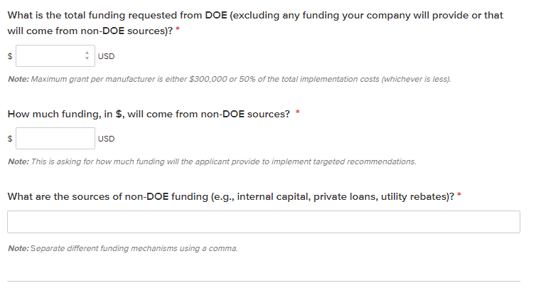
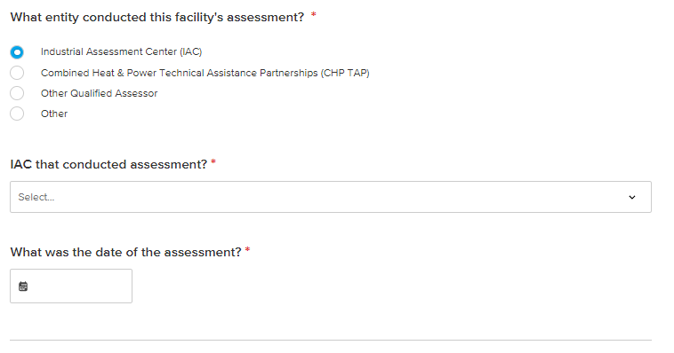
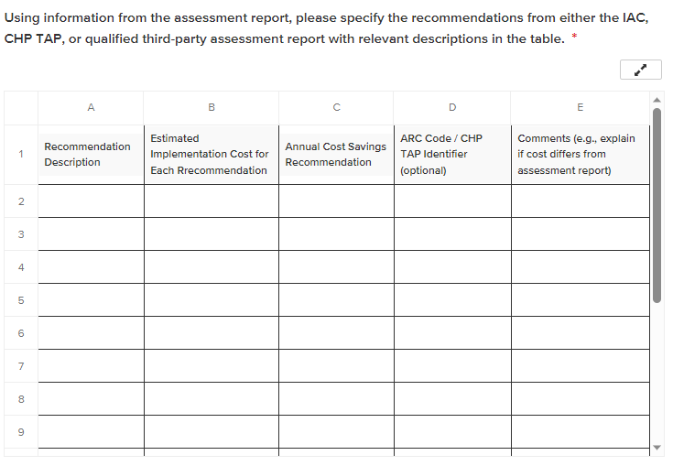
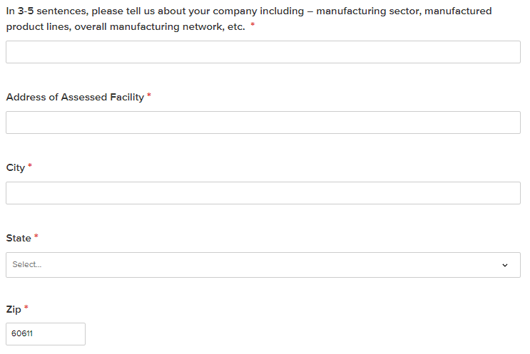
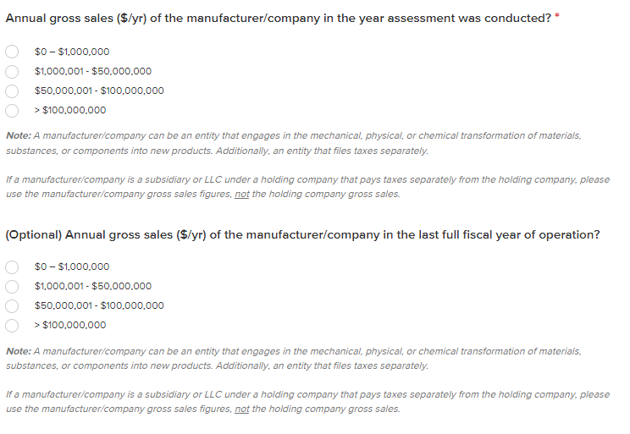
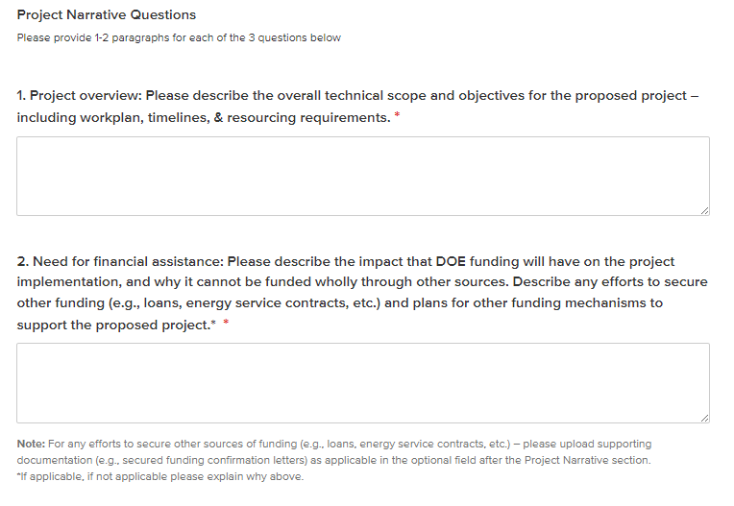
Application Design: IAC Implementation Grants
Grant Funding Request
Entity Information
Working through a “Partnership Intermediary” enables a much more streamlined grant process
Embedded table & questions to simplify grant funding request
Targeted questions to get further detail on firm and facility operation
Entity Eligibility
Project Narrative
Curated questions to help minimize eligibility barriers for grant funding
Simplified Project Narrative to guide applicants to creating a complete proposal

Slide 11
Eligible assessors meet the following criteria:
Workstream 2: Third-Party Assessor Qualification
Applicant is a domestic entity¹
The assessor’s protocol and implementation recommendations are vendor-agnostic for implementation-related products and services
Their assessments are not limited to one or a small set of technology areas or interventions
The assessor is willing, if selected for qualification, to provide its assessment protocols and details on calculations when requested, and to interact with, DOE, the IACs, and other key program stakeholders to share best practices and ensure quality
Identify entities interested in qualifying as a “third-party assessor that provides an assessment equivalent” to an Industrial Assessment Center or CHP/Onsite Energy TAP assessments
1. To qualify as a domestic entity, the entity must be organized, chartered or incorporated (or otherwise formed) under the laws of a particular state or territory of the United States; have majority domestic ownership and control; and have a physical place of business in the United States

Slide 12
Third-Party Assessor Qualification Goals
Expand eligibility and access of IAC Implementation Grant Funding
Qualify proven energy assessments to drive further energy savings
Develop a cohesive assessor network to share best practices and activities
Notes:
Expand eligibility and access to grant funding to SMMs
Onboard existing entities with proven robust energy assessments
Develop a cohesive assessor network including IAC, CHP TAPs, and Qualified Third-Party Assessors

Slide 13
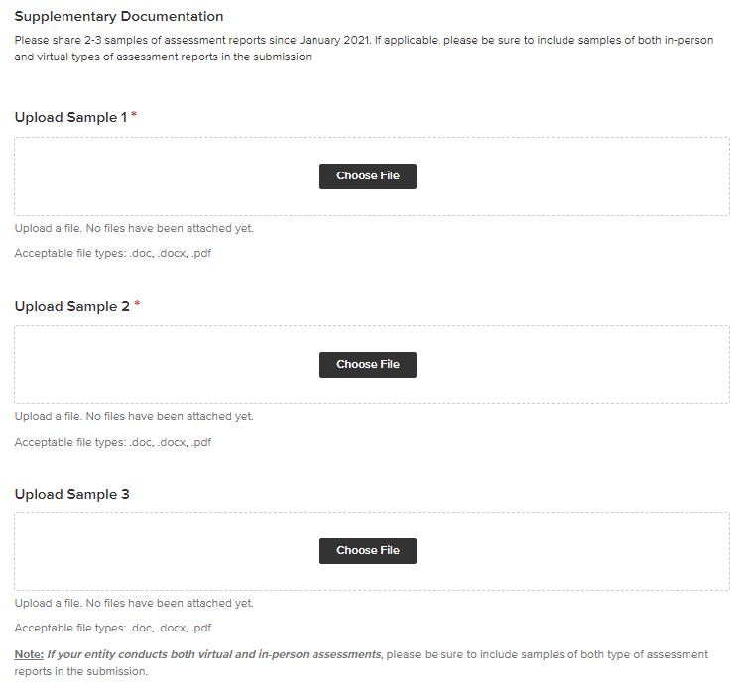
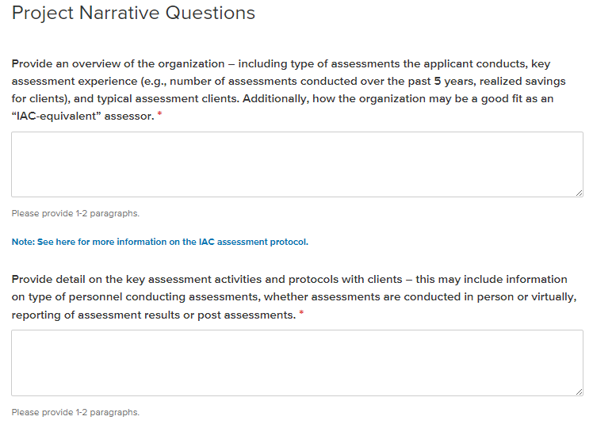
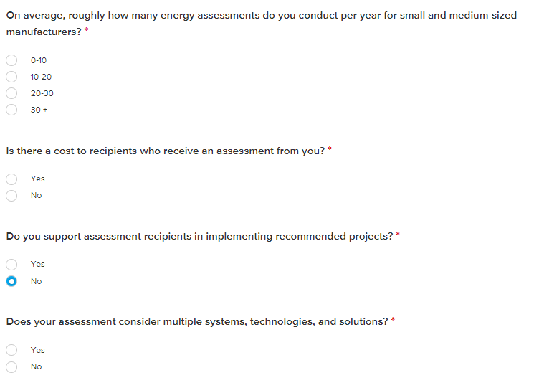
Application Design: Qualified Third-Party Assessor
Assessment Capabilities
Sample Assessments
Project Narrative
Directed questions to collect additional information on assessor’s assessment scope, protocol, and capabilities
Request for assessment reports including - detail on key activities, proposed recommendations, est. implementation costs & savings
Simplified Project Narrative to minimize burden on applicants while ensuring critical information is collected

Slide 14
The Application Process
When to Apply?
The IAC grants program
operates on a rolling basis and applications may be submitted at any time through the year, with reviews after the following deadlines:
December 31, 2023
March 31, 2024
June 30, 2024
September 30, 2024
How to Apply?
In contrast to traditional DOE funding opportunities, the IAC grants program has a very simple and straightforward application form and process via Submittable
Workstream 1 (Implementation Grants Funding) Application
Workstream 2 (Third-Party Assessor Qualification) Application
Other Questions?
The IAC grant program team will be hosting informational monthly office hours:
Nov. 16, 2023, from 1:00-2:00 PM ET: Click here to RSVP
Dec. 7, 2023, from 1:00-2:00 PM ET: Click here to RSVP
Click here to review frequently asked questions (FAQs). If you have additional questions, please contact ENERGYWERX: info@energywerx.org

Slide 15
Timeline and Key Dates
October 6, 2023: Grant Program Opened
October 19, 2023: October Office Hour Session
November 16, 2023: November Office Hour Session
December 7, 2023: December Office Hour Session
December 31, 2023: Application Due Date
Early Spring 2024: Final Selection Date
Spring 2024: Grant Distribution and Third-party Assessment Qualification
Today

Slide 16
Helpful Links
 | Resource | Link
 | IAC Opportunity Announcement (including FAQs) | DOE Industrial Assessment Centers (IAC) Implementation Grant Program - Open Solicitation | Energywerx
 | Workstream 1 Application | ENERGYWERX Submission Manager - Workstream 1: Implementation Grants: 2018-2023 IAC or CHP TAP Assessments (submittable.com)
 | Workstream 2 Application | ENERGYWERX Submission Manager - Workstream 2: Third-Party Assessor Qualification Questionnaire (submittable.com)
 | DOE Press Release | Biden-Harris Administration Announces $80 Million To Strengthen American Manufacturing | Department of Energy
 | MESC IAC Implementation Grants | Industrial Research and Assessment Center Implementation Grants | Department of Energy
 | IAC Program | Industrial Assessment Centers (IACs) | Department of Energy
 | CHP TAP Program | CHP Technical Assistance Partnerships (CHP TAPs) | Better Buildings Initiative (energy.gov)
 | Sign up for MESC Alerts for future funding Opportunities | DOE Office of Manufacturing and Energy Supply Chains (govdelivery.com)

Slide 17
Questions?
Email: info@energywerx.org
Thank you!

Slide 18
Connect With MESC

Slide 19
Appendix

Slide 20
Third-Party Assessor Qualification Criteria
What is IAC Equivalency?
Further Review Criteria
Pre-assessment information gathering
Engagement with key plant personnel
Pre-assessment data analysis
Comprehensive facility assessment (across tech areas)
Clear, vendor-agnostic recommendations based on transparent calculations
Post-assessment follow-up
Workforce development, SMM affordability
Assessor has experience conducting industrial energy assessments
Assessor assessments are either free or demonstrably affordable to small- and medium sized manufacturers
Assessor generates final reporting with information and transparent calculations of impacts of recommendations
Assessor capabilities, client-base, and geographical coverage help extend or fill important gaps in IAC’s network
Assessor commits to driving workforce development
For more information on the third-party qualification requirements, please visit
https://www.energywerx.org/opportunities/iac-round-2

Slide 21
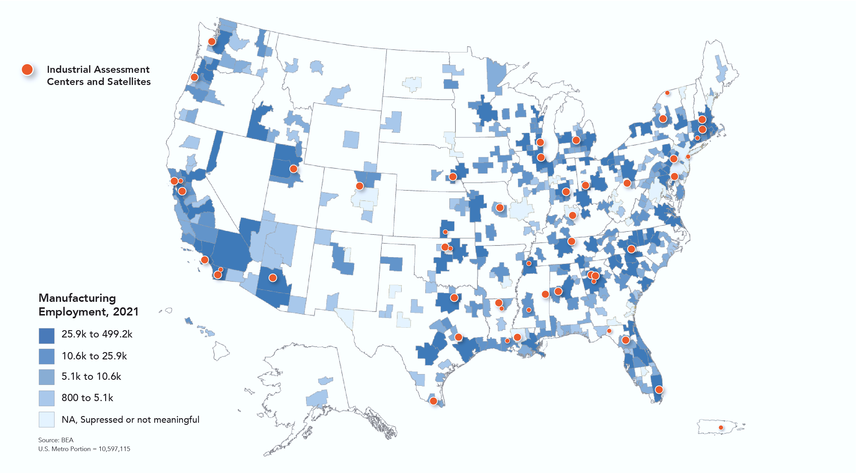
Third-Party Assessor Selectees

Slide 22
Third-Party Assessor Process and Onboarding
Apply to be a Qualified Third-party Assessor
DOE to review Third-party Assessor Application
Selection of Third-party Assessor
Officially Qualified Third-party Assessor
Sign Memorandum of Understanding (MOU)

Slide 23
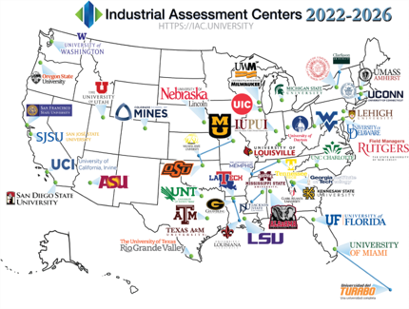
Overview: Industrial Assessment Centers (IACs)
IAC Program
37 universities around the country have conducted over 20,000 IAC assessments over more than 40 years
The program provides technical assistance to small- and medium-sized manufacturing firms while training the next generation of energy-savvy engineers​
Assessments typically identify >$130K in potential annual savings, with ~$50K implemented in the first year – and the potential for much more with the implementation grants
To learn more and apply for an IAC assessment, visit iac.university

Slide 24
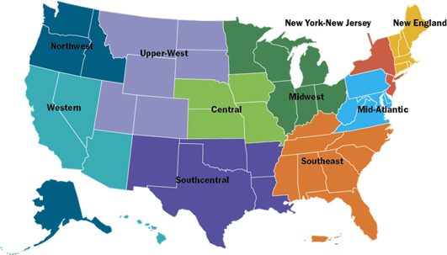
Overview: Combined Heat and Power Technical Assistance Partnerships (CHP TAPs)
CHP TAP Program
10 regional entities around the country have conducted >1000 technical screenings over the past 5 years​
Partner with manufacturers to identify cost effective & resilient ways to deploy combined heat & power (CHP)​
Identify and address barriers to using CHPs to advance regional efficiency, promote energy independence, & enhance the nation’s grid resiliency
To learn more and apply for a CHP TAP assessment, visit https://betterbuildingssolutioncenter.energy.gov/chp/chp-taps

